Slide 1
Course Information
Logic Design Lab.
Fall 2019
Prof. Sungjoo Yoo
(yeonbin@snu.ac.kr)
TA. Hyunsu Kim
(gustnxodjs@gmail.com)
TA. Hyunyoung Jung
(gusdud1500@gmail.com)

Slide 2
Course Information
Course board http://etl.snu.ac.kr Practice slides and notice will be uploaded on eTL Please check the eTL board very often
Submit your homeworks on eTL
Lab computer account Use your CSE account
Contact
TA. Hyunsu Kim (gustnxodjs@gmail.com)
TA. Hyunyoung Jung (gusdud1500@gmail.com)

Slide 3
Course Information
Grading 1: Assignments(up to 35% of final score)
Attendance/Active participation 30%
Attendance check : 7:00 pm
An excuse for inevitable absence or lateness must be sent to TA by email, BEFORE class starts. (The excuse must be reasonable following by the department regulation. Unless it would not be accepted.)
2 lateness → 1 absence
Quizzes, reports and assignments 30%
Term Project 40%
Grading 2: Practice evaluation(10% of final score)
TA will check whether students finished everyday lab
Any report of ill-mannered action → -50% point from each week
Any kind of residue on the table
Careless use of measurement system(e.g., power supply)

Slide 4
Course Information
Assignment (report)
Must include the result and discussion of the practice in one file
# of pages doesn’t matter
The file size should be less than 15MB
Due: Before next class begins (7:00pm)
Late Policy:
24 hour late: -20%
48 hour late: -50%
72 hour late: -100%
Details on lecture syllabus

Slide 5
Course Information
Laboratory Manners
Save material
Place back on the right place (ex. TTL gate)
Cleaning up your desk and turn off the computer, power supply, oscilloscope..
Cheating
Quiz, reports(assignments) must be your personal
Cheating will be reported to the professor, and all the grades will turn to ZERO

Slide 6
Lab. 01
Logic Design Lab.
Fall 2019
Prof. Sungjoo Yoo
(yeonbin@snu.ac.kr)
TA. Hyunsu Kim
(gustnxodjs@gmail.com)
TA. Hyunyoung Jung
(gusdud1500@gmail.com)

Slide 7
Contents
Introduction to Logic Design Lab.
Hardware design
Test method
Computer Simulation
Prototyping
Practice
Logic gates
Breadboard
Homework

Slide 8
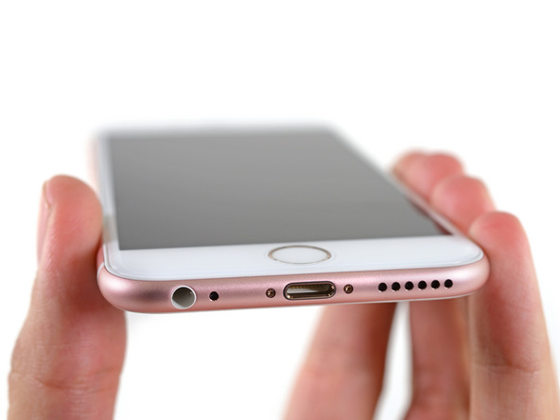
HW Design: iPhone Teardown
[iFixit]

Slide 9
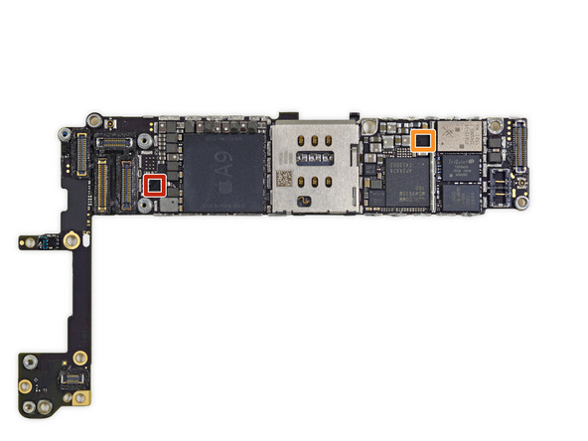
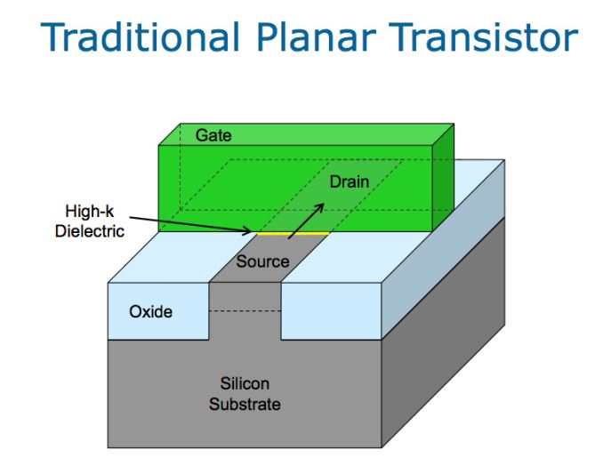
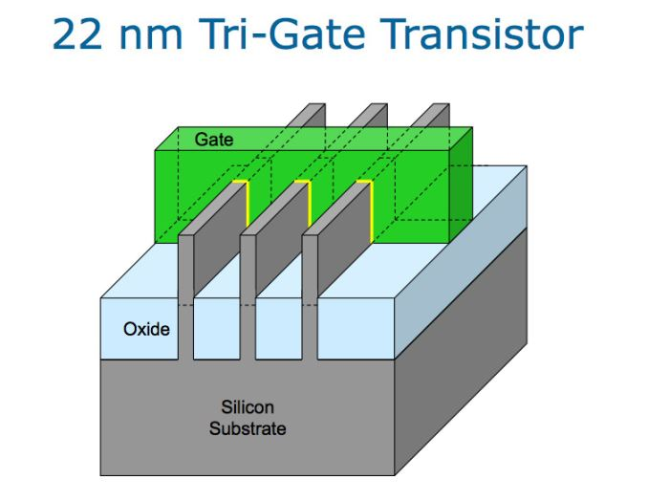
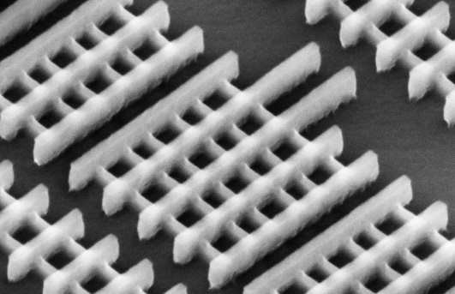
HW Design: A9 Chip
[iFixit]
How many transistors on A9 chip?

Slide 10
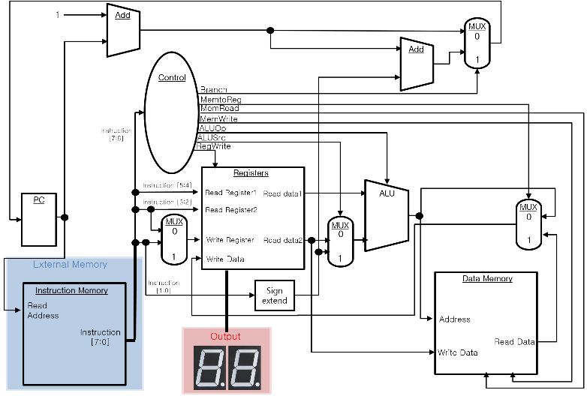
HW Design: Logic Gate to Microprocessor
Microprocessor
Circuit
ERR
closed
C1!=value & new
C2!=value & new
C3!=value & new
S1
S2
S3
OPEN
reset
closed
C1=value & new
closed
C2=value & new
closed
C3=value & new
open
not new
not new
not new
OUT1
OUT2
OUT3
OUT4
D
Q
D
Q
D
Q
D
Q
CLK
Logic Gates
in Combinational circuit
"1"
Finite State Machine
& Sequential circuit

Slide 11
Terminologies: Hierarchical design

Slide 12
Terminologies: Hierarchical design

Slide 13
HW Design: Logic Gate to Microprocessor
Microprocessor
Circuit
ERR
closed
C1!=value & new
C2!=value & new
C3!=value & new
S1
S2
S3
OPEN
reset
closed
C1=value & new
closed
C2=value & new
closed
C3=value & new
open
not new
not new
not new
OUT1
OUT2
OUT3
OUT4
D
Q
D
Q
D
Q
D
Q
CLK
Logic Gates
in Combinational circuit
"1"
Finite State Machine
& Sequential circuit

Slide 14
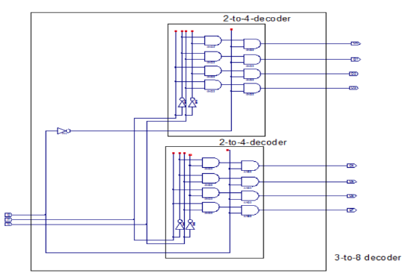
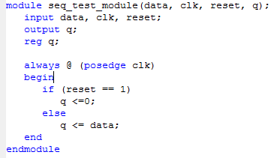
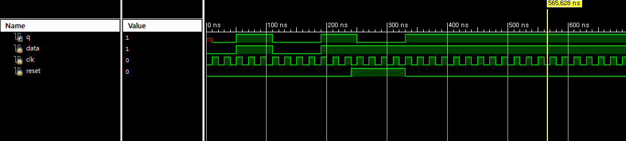
Test method
Computer Simulation
Schematic Design
Hardware Description Language

Slide 15
Test method
Prototyping Building an actual circuit to a theoretical design to verify that it works, and to provide a physical platform for debugging it if it does not.
Breadboard
Universal Board (Wire wrapping / Soldering)

Slide 16
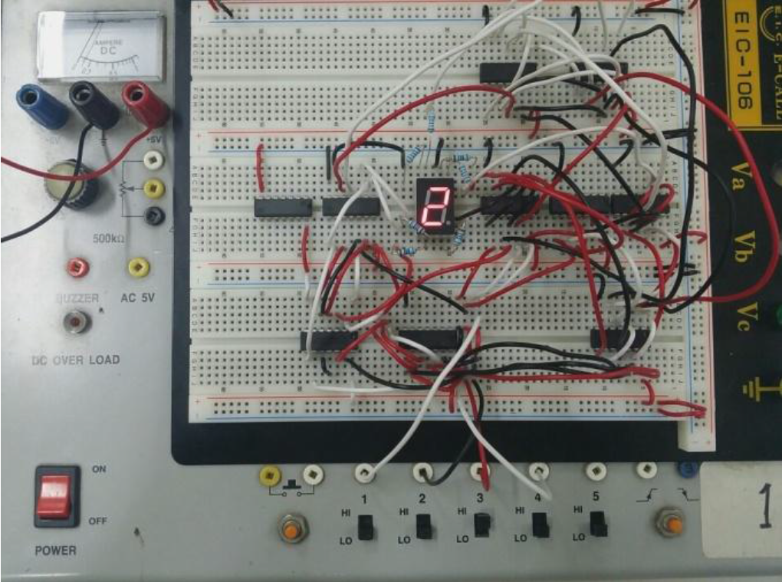
Prototyping: Breadboard
Breadboard

Slide 17
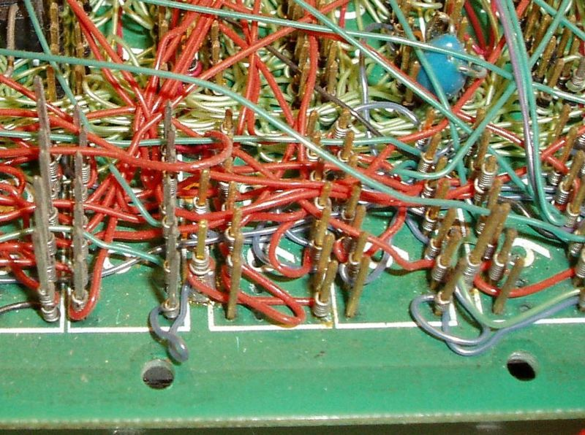
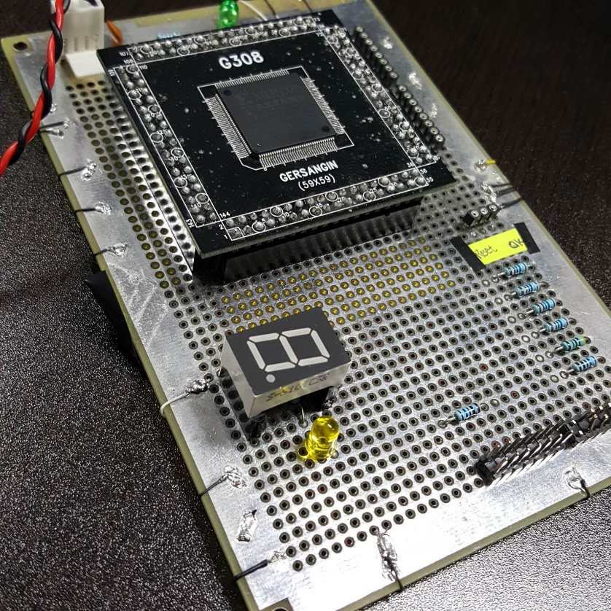
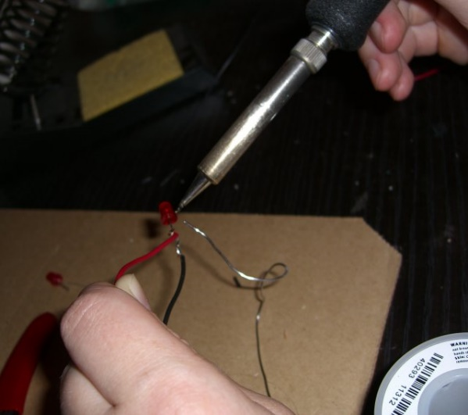
Prototyping: Universal board
Universal Board (Wire wrapping & Soldering)
Wire wrapping
Soldering

Slide 18
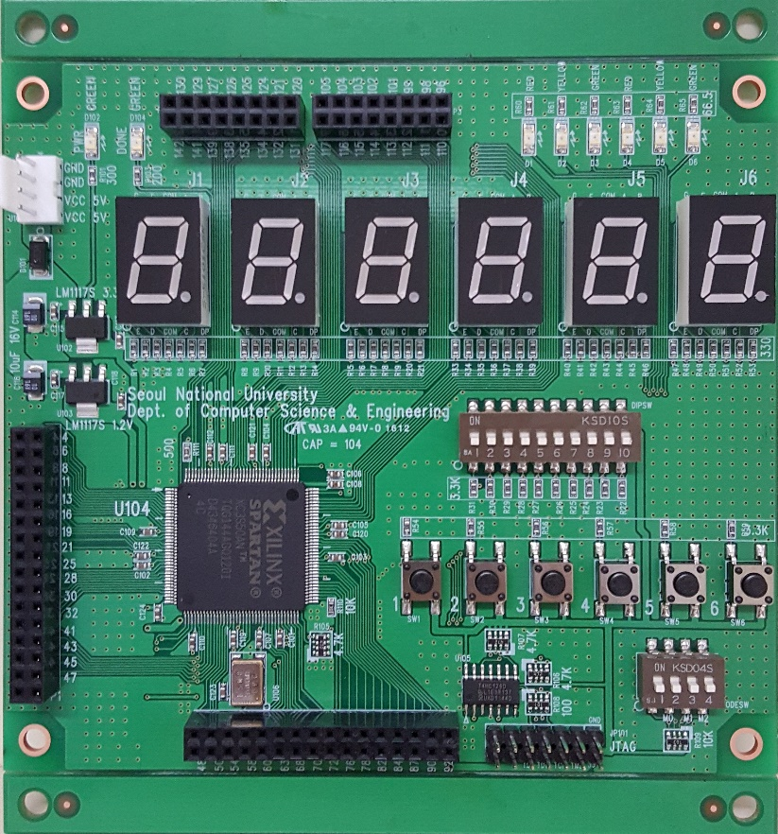
Prototyping: FPGA
Actual Circuit Board
You can build your own board of your logic design with logic gates and electronic parts.
This is SNU’s logic design evaluation circuit board.
You will make a computer with this for the term project.
Evaluation Circuit Board

Slide 19
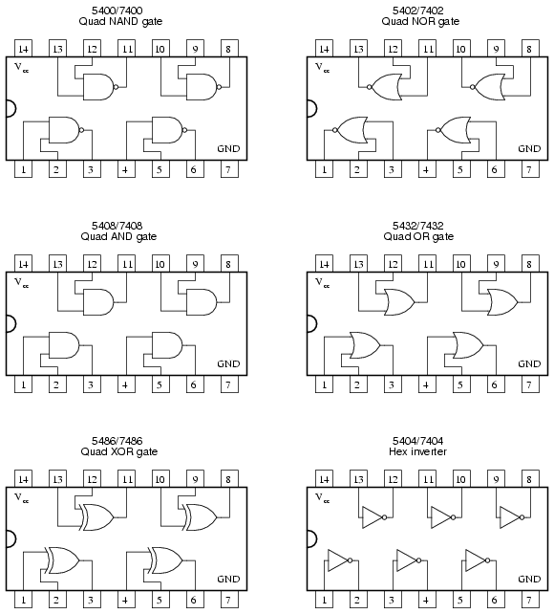
Logic gates
Logic Gates

Slide 20
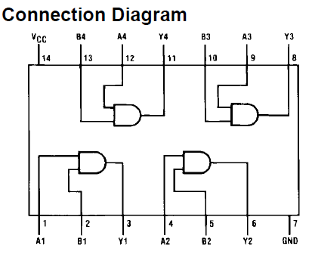
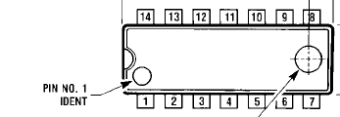
Logic gates
2-Input AND Gate (7408)
Y = A·B
Inputs |  | Output
A | B | Y
0 | 0 | 0
0 | 1 | 0
1 | 0 | 0
1 | 1 | 1

Slide 21
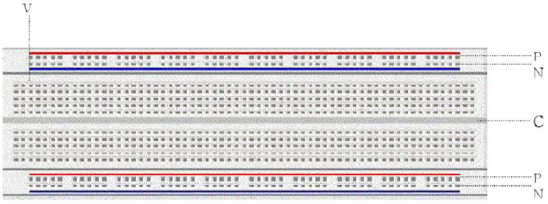
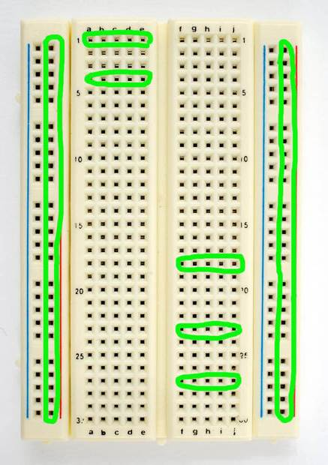
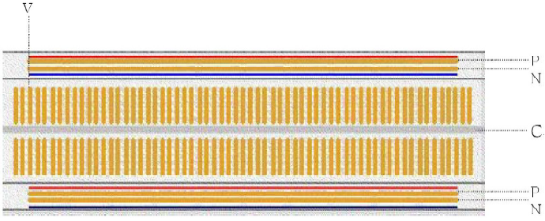
Breadboard
Bread board
Internal wiring of Bread board
You can construct testing the circuit using the bread board, before soldering or wrapping.

Slide 22
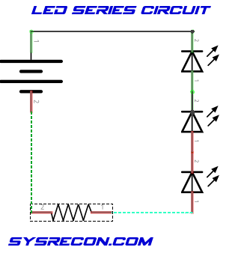
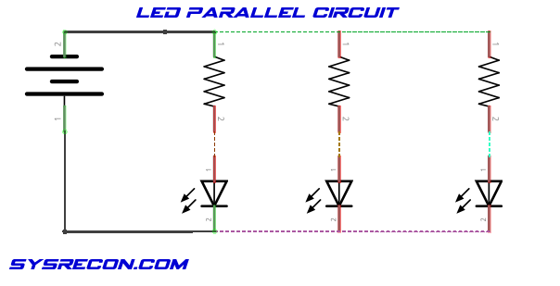
Breadboard

Slide 23
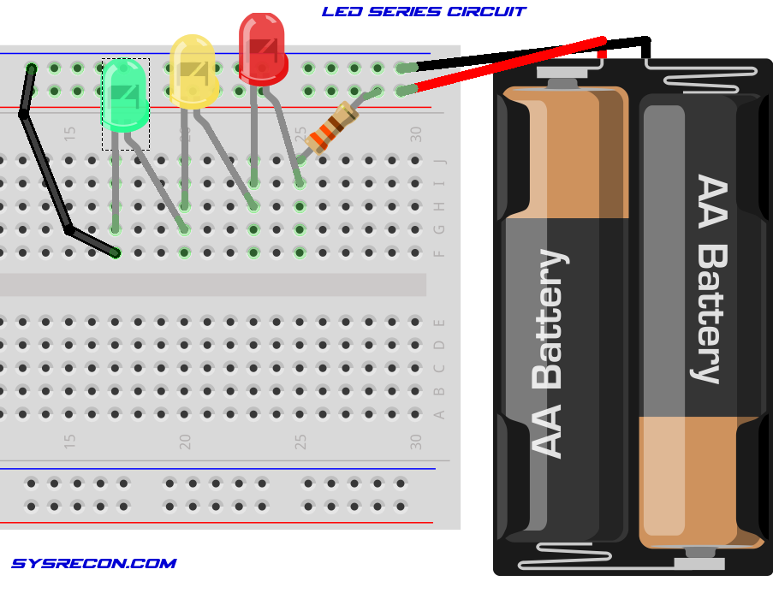
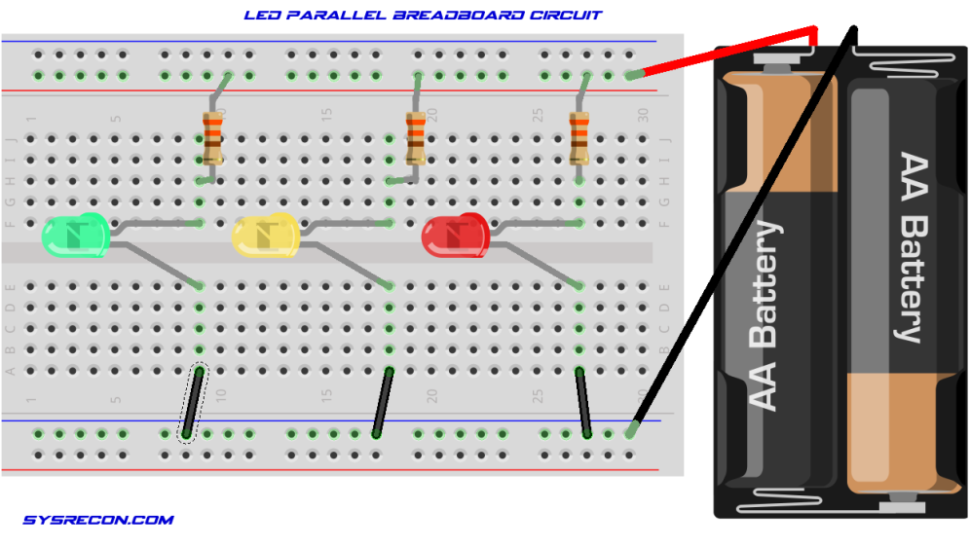
Breadboard

Slide 24
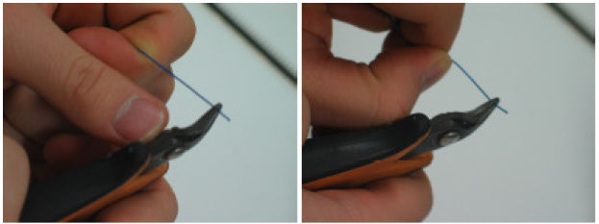
Breadboard
Wiring
Use ‘bead nipper’ to rip off coating.
Push ‘bead nipper’ using your tip or joint of left thumb ( as Figure above ) – for the right-hander.
Ripping off coating

Slide 25

Breadboard
Extracting chips
To extract IC chips, use the IC Chip extractor.
Do not extract by hands, in order to reuse chips.

Slide 26
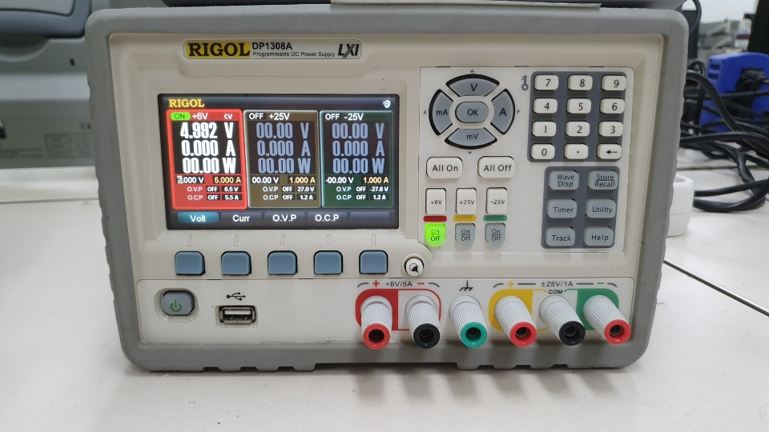
DC Power Supply
Press according to the number written.
2
3
1
power

Slide 27
Practice
Show TA that 7400 NAND Gate works on Breadboard
Use LEDs, wires, resistor and switches from lab cabinet

Slide 28
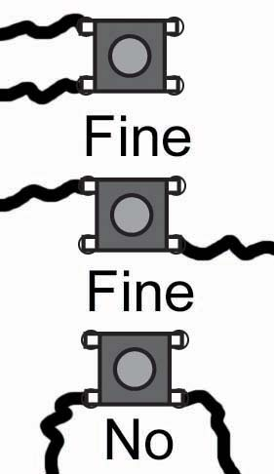
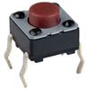
Appendix: tactile switch
Tactile switches
①
④
④
①
③
②
②
③
Tactile Switch
Circuit Diagram
Usage

Slide 29
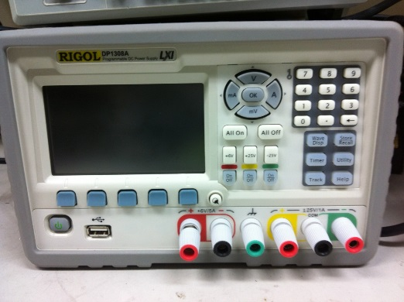
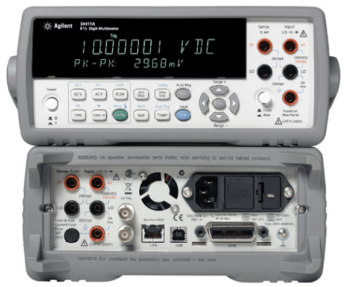
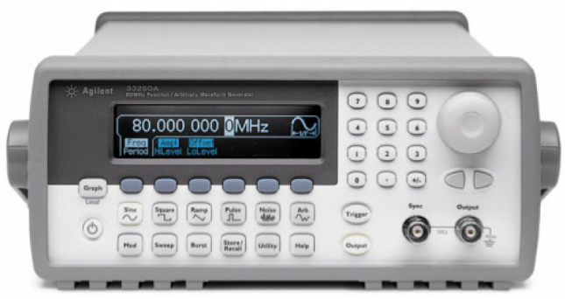
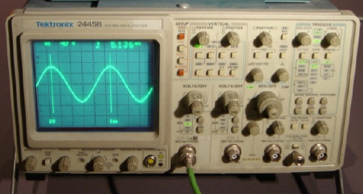
Homework
1. Explain each of the instruments below
DC Power Supply
Multimeter
Function Generator
Oscilloscope

Slide 30
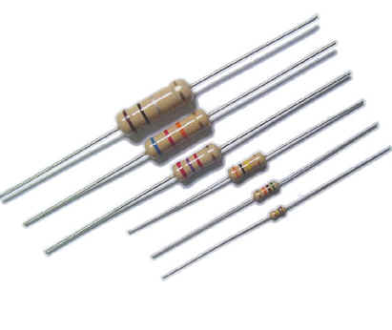
Homework
2. Explain how to read resistor color coding

Slide 31
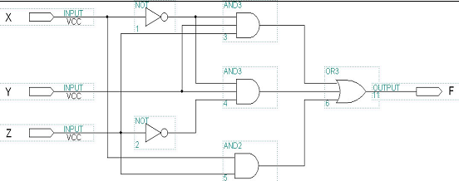
Homework
3.
a) Build a truth table for the circuit above

Slide 32
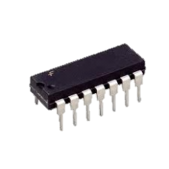
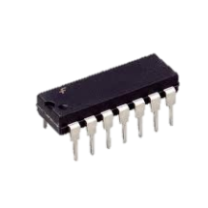
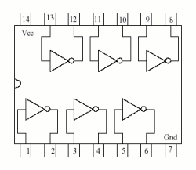
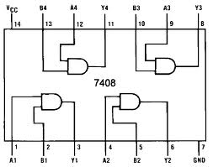
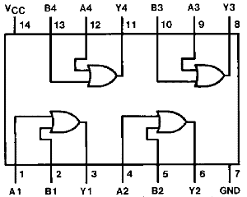
Homework
3. b) Draw the circuit wiring diagram for using NOT gate, AND gate and OR gate
NOT gate (7404)
2-input AND gate (7408)
2-input OR gate (7432)

Slide 33
Ex) Circuit wiring diagram
X
Y
Z
F

